Slide 1
A TRANSITION TRILOGY
THREE TRANSITION TOPICS THAT HAVE NOT BEEN DISCUSSED BEFORE AND THAT YOU REALLY NEED TO UNDERSTAND
Performed by Earl M. Douglas, DDS, MBA, BVAL

Slide 2



Some housekeeping
“Dental educational institutions have an obligation to disseminate new knowledge related to dental practice. In so doing, some presentations may include controversial materials or commercial references. Sponsorship of a continuing dental education course by The University of Tennessee Health Science Center UT College of Dentistry does not necessarily imply endorsement of a particular philosophy, views expressed, procedure, or product by this institution.”
PARTICULARLY THIS PRESENTATION.

Slide 3

Some more housekeeping
I, declare that neither I nor any member of my family has a financial arrangement or affiliation with any corporate organization offering financial support or grant monies for this continuing dental education program, nor do I have a financial interest in any commercial product(s) I will discuss in the presentation.
However, my cat, stella….

Slide 4
So what’s the point of all of this?
IT’S MY GOAL THAT THIS PRESENTATION WILL MAKE YOU BETTER EQUIPPED TO MAKE THE BEST-INFORMED TRANSITION DECISIONS IN YOUR OWN BEST INTEREST.
LEARNING THE FOLLOWING SUBJECTS WILL RESULT IN THAT GOAL BEING ACHIEVED

Slide 5

THE TRILOGY
The three songs
DIXIE – This segment analyzes corporate buyers and their strategies to purchase your practice.
THE BATTLE HYMN OF THE REPUBLIC – This segment will review standards for practice production and overhead expense AND HOW TO make your practice more valuable and desirable.
ALL MY TRIALS – This segment will address some of the sticky issues that buyers and sellers are beginning to encounter in their transitions.

Slide 6
DIXIE
Let’s start by learning how to evaluate offers TO BUY YOUR PRACTICE
  This understanding can literally save you hundreds of thousands of dollars.
  A client I recently WORKED WITH discovered how he could come out $3.5 Million dollars ahead BY UNDERSTANDING HIS OPTIONS.
  The skill of analyzing offers is beSt left to experts WHO HAVE the tools and experience to dissect an offer and see it for what it really is.

Slide 7
DIXIE
  It can be quite costly to look at a very attractive – on the surface – offer and decide that there is no need for an expert opinion since the offer is so unbelievably good.
  It is not what you know that BEST serveS your interests, but learning what you didn’t know.

Slide 8
DIXIE
THE KEY TAKEAWAY IN THIS SECTION IS TO UNDERSTAND THAT PRICE IS ONLY A PART OF THE OFFER.
A HUGE PRICE CAN BE VERY FLATTERING, BUT IT IS STILL BE A SMALL PART OF THE OVERALL BOTTOM LINE.
WHILE VERY LARGE PRICES CAN BE PAID, IT’S ESSENTIAL TO KNOW WHO IS PAYING THAT BIG PRICE – THE BUYER, OR YOU.
THE EXPERT ANALYSIS OF ANY PRACTICE OFFER HAS TO DRILL DOWN TO THE FINAL, LAST BOTTOM LINE.
STOPPING ANYWHERE SHORT OF THE ABSOLUTE BOTTOM LINE CAN SERIOUSLY MISLEAD A SELLER IN THEIR SALE DECISIONS.

Slide 9

DIXIE
JUST REMEMBER THAT IMPORTANT SCIENTIFIC PRINCIPLE –
YOU CAN’T GET TEN POUNDS OF POTATOES OUT OF A FIVE POUND SACK.

Slide 10
DIXIE
WHAT ARE THE ELEMENTS OF AN OFFER?
PRICE
TERMS, OR HOW IS THE PRICE PAID
CONDITIONS, OR WHAT ELSE IS REQUIRED OF ME IN THIS SALE (LIKE WHAT’S THE CATCH?)
TIMING, OR HOW LONG WILL I BE INVOLVED IN THE PROCESS
COMPENSATION, OR WHAT WILL I BE PAID FOR MY WORK IN THE PROCESS

Slide 11

DIXIE
IT TAKES THE SUM OF ALL OF THOSE CONDITION ELEMENTS TO UNDERSTAND WHAT THE OFFER REALLY IS.
JUST BEING FLATTERED BY THE PRICE AND NOT FACTORING IN THE OTHER CONDITIONS CAN LEAD TO A VERY PAINFUL RESULT.

Slide 12
DIXIE
PRICE IS THE EASIEST ELEMENT TO UNDERSTAND.
WE KNOW THAT THE AVERAGE PRACTICE, IF THERE EVER WAS SUCH A THING, SELLS FOR 64% OF LAST YEAR’S GROSS REVENUES.
PRICES ABOVE THAT AMOUNT ARE GOOD AND WAY ABOVE THAT AMOUNT ARE EXCELLENT.
PRICE IS USUALLY THE LEADING ACTOR IN AN OFFER BECAUSE IT MAKES SUCH A BIG IMPRESSION.

Slide 13
dixie
terms
  Terms CAN BE more important than price.
  Remember thE REDNECK lotterY with THE $100 million dollar payoff?
  the PAYOFF terms were a dollar a year for 100 million years.
  It’s critical to know what the payout is for that big price they flashed at you FOR YOUR PRACTICE.
  smart businessmen tell sellerS that the seller can name the price if HE can name the terms.
  Remember that money received in the future is less valuable than money received today.

Slide 14
DIXIE
TERMS
  Have your expert figure a net present value of future receipts to see how much MONEY you’re losing by waiting.
  KEEP IN MIND THAT MONEY PROMISED IS NOT ALWAYS MONEY DELIVERED. YOU MIGHT NOT GET PAID.
  A FRIEND OF MINE TOLD ME THAT HIS DADDY ALWAYS TOLD HIM TO KEEP HIS MONEY TIED UP IN CASH.
  RECEIVING STOCK INSTEAD OF CASH MIGHT SOUND GOOD, BUT I’D LISTEN TO MY FRIEND’S DADDY.
  CASH AT CLOSING IS THE ONLY CERTAINTY OF GETTING PAID THE WONDERFUL PRICE YOUR WERE OFFERED.

Slide 15
DIXIE
TERMS
  MANY TIMES A CORPORATE OFFER WILL INVOLVE THE FULL PRICE BEING CONTINGENT ON THE PRACTICE MEETING POST-SALE QUOTAS IN REVENUES.
  THINK ABOUT IT, HOW MUCH CONTROL DO YOU HAVE ON THEIR FUTURE REVENUE PERFORMANCE?
  IT’S THEIR PRACTICE, NOT YOURS, AND YOU CAN’T CONTROL IT, SO KEEP THAT IN MIND.
  IF YOU DO ACCEPT A DEAL LIKE THAT, MAKE SURE IT’S BASED ON PRODUCTION, NOT COLLECTIONS.
  REMEMBER THAT THERE IS AN ACCOUNTS RECEIVABLE PIPELINE TO FILL THAT WILL TAKE A MONTH. OR SO.
  WE DON’T KNOW HOW GOOD THEIR STAFF WILL BE AT COLLECTING FEES AND THAT COULD COST YOU.

Slide 16
DIXIE
CONDITIONS
  WHAT IS REQUIRED OF YOU TO RECEIVE THAT FABULOUS OFFER?
  MANY TIMES IT REQUIRES THAT THE SELLER WORK FOR THE BUYER FOR A PERIOD OF TIME.
  WITHOUT THE SELLER WORKING, THE DEAL MAY NOT BE OFFERED TO HIM.
  YOU NEED TO REALLY DECIDE IF YOU WANT TO WORK ANOTHER TWO TO FIVE YEARS OR IF YOUR FREEDOM IS WORTH MORE THAN THE MONEY.
  KEEP IN MIND, IF YOU’RE LIKE ME, WE’RE IN THE FOURTH QUARTER, AND THIS IS WHEN TIME BEGINS TO BE WORTH MORE THAN MONEY.

Slide 17
DIXIE
TIMING
  How long am I required to work after the sale?
  This is a key question, especially if you waited for a sale when you were REALLY ready to retire.
  how long do you have to wait to get paid in full for your practice?
  CALCULATE the present value discount for future payments - is there interest being paid?
  Timing, as in comedy AND PRACTICE TRANSITIONS, is everything.

Slide 18
DIXIE
Compensation
  In most cases corporate buyers will require sellers to work post-sale.
  Many times corporate buyers will pay the seller a commission of 25%.
  IT IS IMPORTANT TO KNOW THAT THE AVERAGE SELLER EARNS 52% OF THEIR PERSONAL PRODUCTION IN THEIR OWN PRACTICE.
  WORKING FOR FOUR YEARS FOR 27% LESS INCOME IS A HUGE CLAW BACK OF THAT LARGE FLATTERING PRICE.
  COMPENSATION IS THE BIGGEST ELEMENT THAT AFFECTS THE BOTTOM LINE OF AN OFFER.

Slide 19

DIXIE
LET’S LOOK AT AN ACTUAL CASE OF A FANTASTIC OFFER.
A DENTIST IN A LAND FAR, FAR AWAY – GEORGIA – IS GROSSING $3.5mm.
THREE DSO’S MADE OFFERS TO PURCHASE THE PRACTICE FOR $4mm.
WHAT COULD BE SWEETER?

Slide 20
DIXIE
IT WOULD BE A WASTE OF MONEY TO PAY AN EXPERT TO TELL HIM WHAT TO DO, RIGHT?
HE WAS OFFERED 115% OF HIS GROSS FOR HIS PRACTICE.
BETTER YET, THEY OFFERED TO PAY HIM A SALARY TO WORK FOR FIVE MORE YEARS FOR THEM.
WHILE THEY ALL OFFERED THE SAME PRICE, THE TERMS, CONDITIONS, TIMING, AND COMPENSATION WERE SLIGHTLY DIFFERENT.
BEING A FOOLISH PERSON, HE DECIDED TO SQUANDER HIS MONEY ON AN EXPERT TO HELP DECIDE WHICH OFFER WAS BEST.
I WAS GLAD HE DID. SO WAS HE.

Slide 21
DIXIE
HERE’S WHAT WE DISCOVERED

Slide 22
DIXIE
AND THEN WE DISCOVERED THIS…

Slide 23
DIXIE
DID YOU SEE WHAT I SAW?
LET’S COMPARE THE TOTAL REVENUES FROM EACH ALTERNATIVE.
PURCHASE PRICE
COMMISSION FOR POST-SALE WORK BY SELLER
ANY BONUS PERKS, STOCK OPTIONS, ETC.

Slide 24
DIXIE
BUYER 1 PROVIDES A TOTAL PRICE AND COMMISSION PACKAGE OF $6.9 MM
BUYER 2 PROVIDES A TOTAL PRICE AND COMMISSION PACKAGE OF $6 MM
BUYER 3 PROVIDES A TOTAL PRICE AND COMMISSION PACKAGE OF $5.2 MM
WHICH OPTION LOOKS BEST TO YOU?

Slide 25
dixie
Let’s consider another option, one I think you’ll like better.
Very few dentists imagine this far superior alternative.

Slide 26
DIXIE
OR HOW ABOUT EVEN THIS?
IMAGINE THAT! JUST KEEP YOUR PRACTICE FOR FIVE YEARS AND LOCK THE DOOR AND YOU COME OUT WITH THE SAME CASH!

Slide 27
DIXIE
THERE ARE OTHER CONSIDERATIONS. VERY IMPORTANT CONSIDERATIONS.
REMEMBER THE COMPENSATION OFFERS. THEY WERE A FIXED SALARY AMOUNT.
MANY TIMES WHEN A CORPORATE BUYER TAKES CONTROL, THEY WILL LOAD UP THE GROSS AS MUCH AS POSSIBLE ADDING MEDICAID AND THE MOST-WORST PLANS.
AFTER ALL THE SALARY IS FIXED SO THERE IS NO EXTRA EXPENSE TO THE OWNER FOR ADDING TO THE SELLER’S SCHEDULE.
SELLER’S MAY FIND THEMSELVES WORKING MUCH HARDER FOR MUCH LESS MONEY THAN THEY WOULD HAVE IMAGINED.

Slide 28
DIXIE
SELLERS MAY ALSO DISCOVER THAT THEY CAN’T WRITE OFF PERSONAL EXPENSES WHEN WORKING FOR A CORPORTION
  HEALTH INSURANCE
  PENSION CONTRIBUTIONS
  TRAVEL
  ENTERTAINMENT
  AUTOMOBILE EXPENSE
  AIRPLANE FUEL
  FAMILY SALARIES
  HOUSEHOLD SUPPLIES
  PERSONAL PAYROLL TAXES
  Well, you get the idea, a whole lot of things

Slide 29

dixie
Other issues to consider when working for a corporate owner
  You may not have input or control on creating and maintaining the culture of your practice.
  You probably won’t choose staff or be able to hire and fire as necessary.
  You may not determine the quality and type of supplies and labs.

Slide 30
dixie
  You might not be able to make equipment upgrades or replacements.
  You might not be able to determine your work schedule.
  you might not be able to take reasonable vacation time.
  You might have to work more hours than you might prefer in your sunset years.

Slide 31
dixie
When going into this final transition that will shape your final practice years, use a cone beam to examine it.
Make sure you have the big picture and a total view and understanding of it
Factors to closely evaluate are
  What work schedule am I obligated to fulfill?
  How will I be paid for post-sale work?
  What benefits will I receive?
  What input will I have on the practice culture, to include fees, staff, managed care plans accepted, marketing, how patients are treated, and everything else that goes into the practice you created.

Slide 32
dixie
And lastly, what is the price? And just as importantly,
  How will the price be paid?
    Is it full price cash at closing?
    Is there a hold back for a number of years?
    If not full price at closing, will there be interest on the delayed amounts?
    Is the price contingent on how well the buyer manages the practice?

Slide 33
DIXIE
AND FINALLY, BE SURE TO COMPARE THE ATTRACTIVELY PRICED CORPORATE OFFERS WITH CONTINUING TO WORK A SIMILAR PERIOD FOR YOURSELF AND THEN SELLING TO AN ACTUAL DENTIST AT ACTUAL FAIR MARKET VALUES.
COMPARE THESE IMPORTANT ITEMS
TOTAL REVENUES FROM SALE PRICE AND POST-SALE COMMISSIONS
THE BENEFITS YOU CAN GIVE YOURSELF THAT A CORPORATE BUYER WILL NOT ALLOW
THE FREEDOM TO MAKE YOUR OWN SCHEDULE AND VACATIONS
WHAT IT’S WORTH TO YOU TO CHOOSE YOUR STAFF, SUPPLIES, LABS, EQUIPMENT, TECHNOLOGY
WHAT IT’S WORTH TO TREATMENT PLAN ACCORDING TO YOUR OWN VALUES

Slide 34
DIXIE
WHILE THERE MAY BE COMPELLING REASONS TO ACCEPT A CORPORATE OFFER, SUCH AS A TERMINAL ILLNESS, DISABILITY, OR BEING IN A VERY LOW DEMAND AREA, MANY TIMES A DENTIST WILL COME TO THE WELL-INFORMED AND REASONED DECISION THAT RUNNING HIS OWN PRACTICE AND SELLING WHEN HE’S REALLY READY TO RETIRE WILL YIELD THE BIGGEST REWARD.
OWNING AND OPERATING UNTIL RETIRING USUALLY PROVIDES THE MOST PRACTICE SATISFACTION RATHER THAN WORKING FOR A CORPORATION.
SELLING AT FAIR MARKET VALUE TO A DENTIST OWNER-OPERATOR WILL ALSO PRESERVE THE PROFESSION OF DENTISTRY RATHER THAN WATCHING IT BECOME A BUSINESS THAT EXISTS SOLELY FOR THE PROFIT OF ITS CORPORATE SHAREHOLDERS

Slide 35
BATTLE HYMN OF THE REPUBLIC
THIS SECTION IS DESIGNED TO HELP MAKE YOUR PRACTICE MORE MARKETABLE AND MORE VALUABLE.
INCREASING MARKETABILITY CAN ALSO ADD TO ITS VALUE.

Slide 36
BATTLE HYMN OF THE REPUBLIC
THE ADVANTAGES OF PROFITABILITY
A PROFITABLE PRACTICE PROVIDES YOU WITH MORE PERSONAL NET INCOME WHILE YOU’RE PRACTICING.
PROFITABLE PRACTICES ARE MORE DESIRABLE BY PURCHASERS.
PROFITABLE PRACTICE ARE EASIER TO GET FINANCINED.
PROFITABLE PRACTICES TYPICALLY COMMAND A HIGHER SALE PRICE.
PROFITABILITY PROVIDES THE CAPITAL FOR UPGRADING EQUIPMENT, TECHNOLOGY, MARKETING, CURB APPEAL, AND EVERY OTHER ESSENTIAL ASPECT OF THE PRACTICE.

Slide 37
BATTLE HYMN OF THE REPUBLIC
UNDERSTANDING THE CONCEPT OF PROFIT
PROFIT IS NOT SIMPLY PRACTICE NET INCOME - THAT IS WHAT IS LEFT OVER AFTER SUBTRACTING EXPENSES FROM THE INCOME.
PRACTICE NET INCOME CONSISTS OF TWO PARTS
SALARY FOR THE OWNER’S WORK
PROFIT
PROFIT IS THE AMOUNT LEFT OVER AFTER SUBTRACTING THE ADJUSTED PRACTICE EXPENSES AND A COMMENSURATE SALARY FOR THE OWNER’S WORK. THINK OF THE OWNER AS AN ASSOCIATE WHO MUST BE PAID FOR THEIR WORK.
PROFIT IS A PRODUCT OF OWNERSHIP, NOT OF WORK.

Slide 38

BATTLE HYMN OF THE REPUBLIC
THERE ARE THREE WAYS TO INCREASE PROFITABILITY
  INCREASE THE GROSS REVENUES
  DECREASE THE OVERHEAD
  DOING BOTH

Slide 39
BATTLE HYMN OF THE REPUBLIC
LET’S TALK ABOUT EXPENSES AND DEDUCTIONS
  EXPENSES ARE THINGS YOU PAY FOR THAT ARE ESSENTIAL TO RUNNING YOUR PRACTICE
    RENT, UTILITIES, TELEPHONE
    internet, computers, software
    SALARIES – FOR STAFF AND OWNER
    LAB AND SUPPLIES
    TAXES
    INSURANCE
    CE
    Repairs
    Legal and accounting

Slide 40
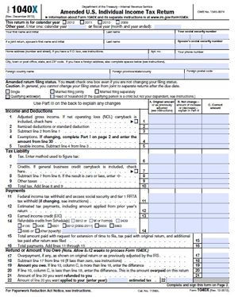
BATTLE HYMN OF THE REPUBLIC
Then there are deductions – items we can deduct from taxable income but ARE not essential practice COSTS
  SOME OWNER PERSONAL INSURANCES
  CE IN EXCESS OF $2,500
  TRAVEL
  AUTOMOBILE
  ENTERTAINMENT
  DEPRECIATION AND AMORTIZATION
  CONTRIBUTIONS

Slide 41
BATTLE HYMN OF THE REPUBLIC
INCOME MUST BE ADJUSTED AS WELL
IN THIS CONTEXT, INCOME MEANS COLLECTIONS, NOT PRODUCTION
WE INCLUDE THIS KIND OF INCOME
  RECEIPTS FROM PATIENTS FOR TREATMENT RECEIVED.
WE DO NOT INCLUDE THIS KIND OF INCOME.
  INCOME FROM WORKING AT OTHER PRACTICES OR BUSINESSES
  INCOME FROM LEGAL SETTLEMENTS
  INCOME FROM REAL ESTATE RENTALS
  INCOME THAT WAS REFUNDED

Slide 42
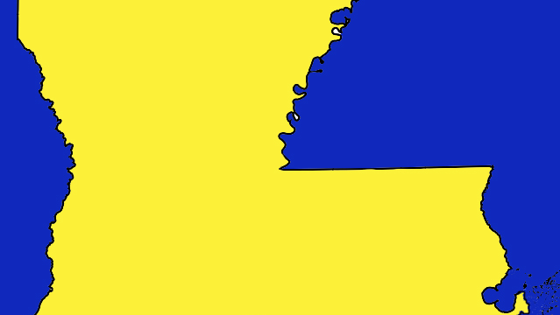
BATTLE HYMN OF THE REPUBLIC
WHEN EXPERTS ANALYZE YOUR PROFITABILITY, NON-ESSENTIAL DEDUCTIONS ARE NOT TREATED AS EXPENSES, BUT AS NET INCOME.
IT TOOK ME A WHILE TO UNDERSTAND WHY MY ACCOUNTANT TOLD ME THAT I SHOULD LEARN TO LIVE VERY COMFORTABLY ON A 25% NET OF MY PRACTICE.
WHAT IS THE STATE WITH THE HIGHEST PERCENTAGE NET FOR DENTISTS? WHY?

Slide 43
BATTLE HYMN OF THE REPUBLIC
PROFIT IS CALCULATED BY SUBTRACTING ADJUSTED EXPENSES FROM ADJUSTED INCOME.
HOW MUCH SALARY SHOULD I MAKE? YOU GET TO DECIDE. I USE AN AMOUNT OF 35% OF PERSONALLY GENERATED REVENUES.
HOW MUCH PROFIT SHOULD I MAKE? THE AVERAGE ADJUSTED NET I SEE IS 52%, SO SUBTRACTING A 35% SALARY RESULTS IN A PROFIT OF 17% OF THE PRACTICE GROSS WHICH TRANSLATES TO 27% OF THE AVERAGE PRACTICE VALUE. THIS TELLS US THE RETURN ON INVESTMENT.
WHAT OTHER INVESTMENTS DO YOU HAVE THAT PAY 27% RATE OF RETURN?

Slide 44

BATTLE HYMN OF THE REPUBLIC
Some owner uses of profit
  College for your children
  Investing for your retirement
  A very nice home
  Nice cars
  A second home, boat, plane, extensive travel, etc
  Upgrading office equipment, technology, image, etc.
  Purchasing your own office building.
  HIGH QUALITY health insurance
  And on and on….

Slide 45
BATTLE HYMN OF THE REPUBLIC
Some purchaser uses of profit
  Pay loan payments for purchase of your practice
  Pay educational debt
  Replace the yugo with a newer car
  Buy a starter home
  Buy technology for the practice
  Start a retirement fund
  And on and on….

Slide 46
BATTLE HYMN OF THE REPUBLIC
PROFIT IS EXTREMELY IMPORTANT FOR BOTH OWNERS AND NEW PURCHASERS.
IT IS ALSO IMPORTANT TO LENDERS WHO FINANCE THE PURCHASE OF YOUR PRACTICE.
DENTAL ACQUISITION LENDERS MAKE IT POSSIBLE FOR SELLERS TO GET PAID 100% OF THE PRACTICE PRICE IN CASH AT CLOSING.
IT’S NOT BECAUSE THEY’RE ALL THAT NICE, BUT BECAUSE THEY SEE THE PROFITABILITY OF A WELL-MANAGED PRACTICE AND ARE CONFIDENT THAT THEY WILL BE PAID BACK.
THE MORE PROFITABLE A PRACTICE IS, THE HIGHER PRICE IT CAN SUPPORT AND THE EASIER IT IS TO GET FINANCED.

Slide 47
BATTLE HYMN OF THE REPUBLIC
INCREASING PROFIT BY INCREASING GROSS REVENUES
  FIRST, WE NEED TO UNDERSTAND THE ECONOMICS OF DENTISTRY, AND EVERY OTHER BUSINESS FOR THAT MATTER.
  THE TAKEWAY HERE IS THAT ONCE THE BREAK-EVEN POINT IS REACHED, OVERHEAD IS ESSENTIALLY ONLY THE EXTRA VARIABLE EXPENSES.
  THESE ARE ESSENTIALLY LAB, SUPPLIES, AND ARE ONLY ~25%.
  YOU NEED TO UNDERSTAND THIS - YOUR OVERHEAD IS NOT 60%. IT IS 100% AT THE BREAKEVEN POINT AND ~25% THEREAFTER.
  THAT MEANS YOU NET ~75% OF EVERYTHING YOU COLLECT ABOVE THE BREAK-EVEN POINT - THAT IS THE MOST PROFITABLE WORK YOU DO.

Slide 48
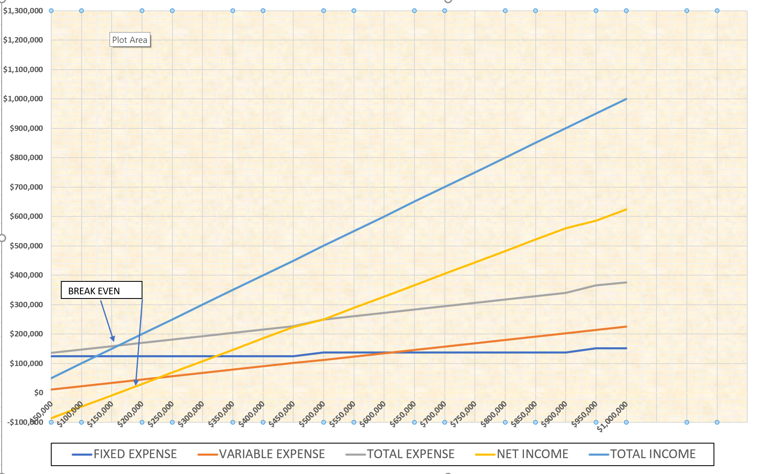

Slide 49
BATTLE HYMN OF THE REPUBLIC
HOW to INCREASE REVENUES
THE BEST WAY IS TO HIRE A COMPETENT MANAGEMENT CONSULTANT.
  THEY CAN IMPROVE SCHEDULING, PRESENTATION OF TREATMENT PLANS, GETTING PATIENT FINANCING, STAFF EFFICIENCY, STIMULATING REFERRALS, MARKETING, AND A HOST OF OTHER TECHNIQUES TO INCREASE REVENUES.
  THEY ARE NOT EXPENSIVE TO HIRE, ONLY VERY EXPENSIVE NOT TO HIRE.
  A GOOD CONSULTANT HAS A SIXTY-DAY PAY BACK PERIOD, AFTER THAT THE MONEY GOES INTO YOUR POCKET.
YOU COULD ADD NEW SERVICES. LIKE TRY DOING ROOT CANALS AGAIN.
IF YOU HAVE SEVERAL YEARS AHEAD OF YOU, CONSIDER A PRACTICE MERGER AND BUY MORE BUSINESS.

Slide 50
BATTLE HYMN OF THE REPUBLIC
AN EXCELLENT WAY OF INCREASING YOUR REVENUE IS TO MAKE SURE YOUR FEES ARE UP TO DATE.
FEE INCREASES HAVE NO OVERHEAD ATTACHED TO THEM SO THEY ARE 100% PROFIT.
OH, DID I MENTION DEPOSITING ALL OF YOUR RECEIPTS, EVEN THE CASH?
THE IRS PAYS REWARDS TO PEOPLE WHO TURN PEOPLE IN FOR TAX EVASION AND THEN PROSECUTES THE OFFENDER AS A CRIMINAL (JAIL) OFFENSE, SO I WOULDN’T MENTION IT IF I DID IT.

Slide 51
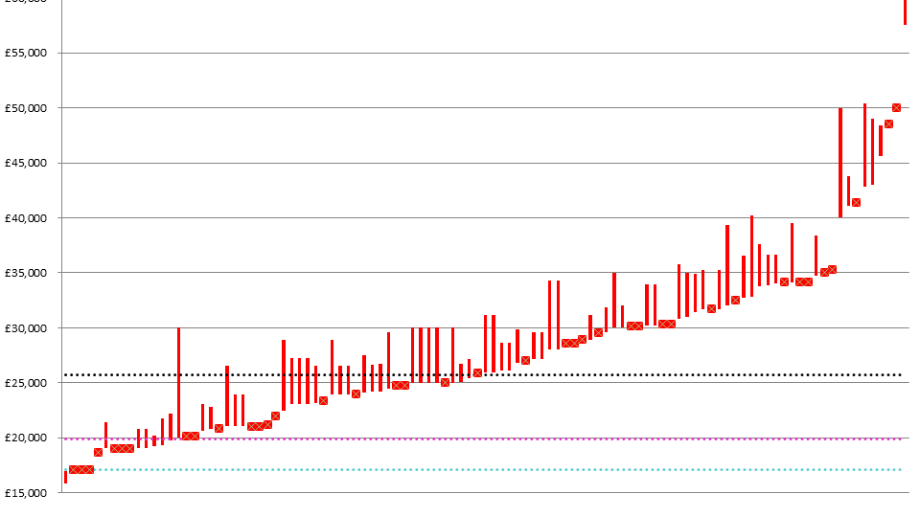
BATTLE HYMN OF THE REPUBLIC
REDUCING YOUR OVERHEAD
  WATCH OUT FOR CREEPING OVERHEAD INCREASES AND KNOW WHAT PRACTICE EXPENSE STANDARDS SHOULD BE AND TAKE ACTION TO ADJUST TO THEM IF YOU’RE OUTSIDE THE NORM.
PRACTICE SALARIES
  SALARIES IS THE PRIME AREA WHERE OVERHEAD GETS OUT OF CONTROL
  IT’S EXPECTED THAT EMPLOYEES GET ANNUAL RAISES, BUT WHAT HAPPENS WHEN YOUR GROSS GOES DOWN?
  IT IS EASY TO BE OVERSTAFFED AND FEEL THAT IT IS NECESSARY, BUT MANY TIMES YOU CAN GET MORE DONE WITH FEWER EMPLOYEES.

Slide 52
BATTLE HYMN OF THE REPUBLIC
STAFF EXPENSE SHOULD BE NO MORE THAT 28% OF YOUR GROSS REVENUES. ALL IN.
  28% INCLUDES, SALARIES, BONUSES, INSURANCE BENEFITS, PENSION CONTRIBUTIONS, PAYROLL TAXES, AND ANY OTHER EXPENSE THAT GOES TO EMPLOYEE BENEFIT.
  LONG TERM EMPLOYEES MAY BE OVERPAID AND UNDERPERFORMING. IT’S POSSIBLE FOR THEM TO LOSE THEIR EDGE.
  NEWER, NOT NECESSARILY YOUNGER, EMPLOYEES ARE USUALLY PAID LESS AND MAY HAVE MORE FIRE IN THEIR BELLY.
  TAKE A GOOD LOOK FOR ANY EXCESS EMPLOYEES – THEY MAY BE HARD TO SPOT, BUT IT’S AMAZING HOW MUCH WORK A FEW GOOD EMPLOYEES CAN PRODUCE.
  THE LOWEST STAFF COST I’VE EVER SEEN. UNBELIEVABLE.

Slide 53
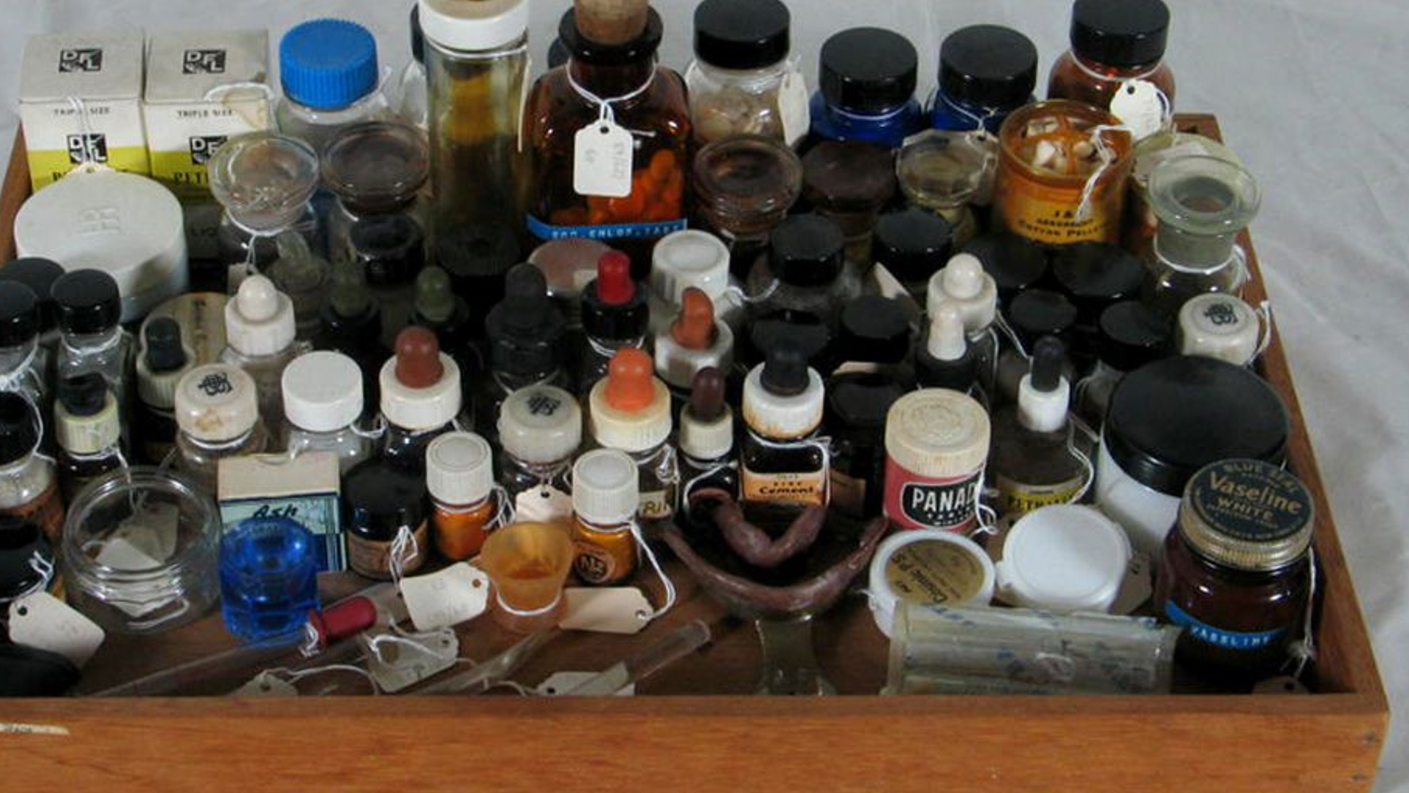
BATTLE HYMN OF THE REPUBLIC
CLINICAL SUPPLY EXPENSE IS THE SECOND AREA FOR OUT OF CONTROL EXPENSES.
  CLINICAL SUPPLY EXPENSE SHOULD BE NO MORE THAT 7% OF YOUR GROSS, UNLESS YOU BUY A LOT OF BLOCKS FOR YOUR CERAC, IN WHICH CASE 9% – 10% IS STILL IN CONTROL.
  THE LOWEST CLINICAL SUPPLY EXPENSE I’VE SEEN WAS 4%.
  THIS IS A RESULT OF SHOPPING ONLINE FOR ONLY SUPPLIES THAT WERE NEEDED. I ASKED IF HE WAS GETTING EXPIRED, OFF-BRAND MATERIALS, AND HE TOLD ME THAT IT WAS FRESH, NAME BRAND GOODS.
  MANY TIMES THE STAFF, AS IT HAS BEEN MY PERSONAL EXPERIENCE, WILL OVERESTIMATE THE NEED FOR SUPPLIES.

Slide 54
BATTLE HYMN OF THE REPUBLIC
OFFICE SUPPLY EXPENSE SHOULD BE NO MORE THAT 2% OF THE GROSS REVENUES.
OFFICE SUPPLY EXPENSE OF OVER 2% IS A SIGN THAT MORE PERSONAL EXPENSE IS BEING RUN THROUGH THIS ACCOUNT.
LAB EXPENSE IS TYPICALLY ~10% BUT DEPENDS ON HOW MUCH PROSTHETICS IS BEING DONE AS WELL AS THE PER UNIT COST OF WORK.
PROSTHETIC PRACTICES MAY HAVE LAB EXPENSE AS HIGH AS 20%, MAKING IT HARD TO FIND PROFIT.

Slide 55

BATTLE HYMN OF THE REPUBLIC
Occupancy expense – rent, utilities, and telephone should total no more than 9% of revenues.
  Rent should be in the range of 6% and utilities and telephone should be no more than 3%.
  If phone and utilities are >3%, I’d guess somehow your home bills got paid by your practice.
  vonage

Slide 56
BATTLE HYMN OF THE REPUBLIC
Tax savings
  I REALIZE WE ARE ALL TRYING TO SAVE ON TAXES AND WANT TO WRITE OFF EVERYTHING WE CAN, BUT BE CAREFUL WHERE you hide your PERSONAL EXPENSES.
  IF YOU’RE GOING TO HIDE your FAT, DON’T PUT IT IN YOUR HEART, LIVER, OR KIDNEYS. PUT IT IN YOUR APPENDIX.
  FOR HIDING PERSONAL EXPENSE, CONSIDER USING
    ENTERTAINMENT, TRAVEL, GIFTS, CONTRIBUTIONS, CONTINUING EDUCATION
  AVOID HIDING PERSONAL EXPENSES IN THESE PLACES
    LAB, CLINICAL SUPPLIES, SALARIES

Slide 57

BATTLE HYMN OF THE REPUBLIC
KEEP IN MIND THE OTHER IMPORTANT SCIENTIFIC PRINCIPLE -
PIGS GET FED, HAWGS GET SLAUGHTERED.

Slide 58
BATTLE HYMN OF THE REPUBLIC
INCREASING MARKETABILITY
BUYING NEW EQUIPMENT IN ORDER TO MAKE YOUR PRACTICE MORE VALUABLE OR SELL QUICKER MAY NOT GIVE YOU THE RESULTS YOU’RE SEEKING.
IT’S HARD TO KNOW WHAT KIND OF EQUIPMENT ANY GIVEN PURCHASER WOULD LIKE
IT’S UNLIKELY TO RECOUP THE COST OF THE PURCHASED EQUIPMENT.
IT WOULD MAKE MORE SENSE TO GIVE BUYER AN ALLOWANCE OR PRICE REDUCTION TO BUY EXACTLY WHAT THEY WANT.

Slide 59
BATTLE HYMN OF THE REPUBLIC
INCREASING MARKETABILITY
IT ALWAYS HELPS TO GET RID OF THE JUNK THAT HAS ACCUMULATED.
THAT JUNK FILLED OPERATORY GIVES A BAD IMPRESSION. GET RID OF THAT STUFF.
SPRUCING UP CAN MAKE A BIG DIFFERENCE IN THE IMPRESSION YOUR OFFICE MAKES.
YOU DON’T NEED A MAKEOVER – A FLUFF JOB WILL DO. JUST LOOK CLEAN, NEAT, AND UNCLUTTERED.
PAY SPECIAL ATTENTION TO YOUR SIGN – WHAT DOES IT SAY ABOUT YOU?

Slide 60
BATTLE HYMN OF THE REPUBLIC
INCREASING MARKETABILITY
IF I WERE TO DO ANYTHING TO REALLY IMPRESS A BUYER, I’D DO THESE THINGS
GET A NEW STERILIZER UNLESS I HAD A VERY HANDSOME UP TO DATE ONE ALREADY
PUT NEW FURNITURE IN THE WAITING ROOM
PUT IN NEW FLOORING
PAINT THE WALLS.
MAKE SURE YOUR COMPUTERS AND SOFTWARE ARE UP TO DATE.
YOU’D BE SURPRISED HOW MUCH DIFFERENCE THAT WOULD MAKE IN THE EYES OF A PURCHASER.

Slide 61
BATTLE HYMN OF THE REPUBLIC
VALUE AND MARKETABILITY GO HAND IN HAND – INCREASING ONE WILL FREQUENTLY INCREASE THE OTHER.
BEAUTY IS IN THE EYE OF THE BEHOLDER, BUT VALUE IS IN THE EYE OF THE ACCOUNTANT AND BANKER.
VALUE MUST BE SUBSTANTIATED BY THE NUMBERS AND THERE IS NO FAKING THEM.
SHOWING THE MOST PROFITABILITY WILL UNDOUBTEDLY RAISE YOUR TAX BILL BUT ALSO YOUR PRACTICE PRICE.

Slide 62
ALL MY TRIALS
MOMMA SAID THERE’D BE DAYS LIKE THIS
TRANSITIONS ARE GETTING MORE COMPLICATED BY THE DAY, JUST LIKE YOUR PRACTICE.
WE’RE GOING TO EXAMINE SOME OF THE ISSUES THAT CAUSE SUCH VEXATION.
BEING AWARE AND PREPARED FOR A PROBLEM MAKES IT HALF SOLVED.

Slide 63
ALL MY TRIALS
THE BIGGEST ISSUE FACING PURCHASERS, AND THEREFORE SELLERS, IS THE CREDENTIALING OF THE PURCHASER BY SELLER’S INSURANCE PLANS
WHEN A PURCHASER BUYS A PRACTICE AND IS NOT CREDENTIALED ON AN INSURANCE PLAN, HE CANNOT BILL THE INSURANCE FOR WORK HE DOES.
THIS CAN RESULT IN A LONG PERIOD OF TIME IN WHICH COLLECTIONS WILL NOT BE COMING IN, RESULTING IN SOME CASH FLOW CRUNCHES.

Slide 64
ALL MY TRIALS
JASON WOOD, AN ATTORNEY IN CALIFORNIA, PRESENTED SEVERAL STRATEGIES THAT HE HAS OBSERVED HAVING BEEN USED BY BUYERS AND SELLERS TO ADDRESS THIS ISSUE.
01
THEY ARE NOT SUGGESTIONS AND THERE IS NO WARRANTY THAT THEY ARE LEGAL
02
THEY ARE JUST OBSERVATIONS OF HOW BUYERS AND SELLERS ADDRESS THE ISSUE.
03
IN OTHER WORDS, DON’T BLAME HIM OR ME IF YOU TRY THEM AND GET IN TROUBLE.
04

Slide 65
ALL MY TRIALS
Strategy I
  The purchaser applies for credentialing for the seller’s plans.
  The purchaser waits for credentialing approval before closing on the purchase of the seller’s practice.
  The purchaser then begins to treat and bill patients’ insurance under his own contract.
  This is a TOTALLY legitimate approach to the issue.

Slide 66
ALL MY TRIALS
  Brokers have a saying, “time kills all deals”, and this approach can consume a lot of time.
  One sale in north Carolina waited six months until the purchaser could obtain his Medicaid number.
  Six months is a long time to depend on a sale actually closing.

Slide 67
ALL MY TRIALS
Strategy II
  The purchaser closes on the purchase of the practice and begins treating patients.
  PURCHASER applies for credentialing and then begins to treat the patients and bills the patient’s insurance as an out of network provider.
  This is a legitimate approach to the issue.
  This strategy may result in some patient attrition due to out of network benefits being lower than in-network benefits.

Slide 68
ALL MY TRIALS
Strategy III
  The purchaser closes on the purchase and applies for credentials in the seller’s plans.
  The purchaser treats patients and bills for payment under the seller’s number.
  The seller deposits the insurance proceeds for the purchaser’s work inTO the purchaser’s account.
  When the buyer receives his credentials, he begins filing claims under his own number.
  The legitimacy of this approach is iffy unless the insurance company is advised of the plan and approves of it.

Slide 69
ALL MY TRIALS
BIG PROBLEM NUMBER TWO - DELTA PREMIER PLANS
  IN MANY AREAS, DELTA WILL NO LONGER ENROLL NEW PROVIDERS IN THE PREMIER PLAN.
  A RESOURCE IN THE INSURANCE CREDENTIALING BUSINESS ESTIMATES THAT delta’s PPO plan would pay 25% less than the premier benefits for the same work.
  Purchasers need to be aware if they will be able to get premier or if they HAVE TO JOIN the regular Ppo AND receive 25% LOWER benefits.
  IF A BUYER CAN’T GET PREMIER AND YOU HAVE A LARGE PROPORTION OF PREMIER BENEFITS, SHOULD IT AFFECT YOUR VALUE?

Slide 70
ALL MY TRIALS
THESE APPROACHES HAVE BEEN USED. i MAKE NO REPRESENTATION AS TO THE LEGALITY OR LEGITIMACY OF ANY OF THEM.
  Buyer CHARGES under the SELLER’S provider NUMBER. A Short-term solution
  Seller remains AFTER THE SALE AS the Dental Director of the practice AS IN A DSO or public health CLINIC. Buyer CHARGES under Seller’s provider NUMBER, Typically FOR ONE TO THREE years.
  Seller remains as an associate AFTER THE SALE AND sees all PREMIER patients. Buyer does not notify Delta of the acquisition of the practice.

Slide 71

ALL MY TRIALS
Buyer acquires the stock of the Seller’s CORPORATION. AND BILLS UNDER the CORPORATION’S EIN indefinitely.
Buyer goes out of network and “balance bills” the Delta patients. THIS HAPPENS Instantly AND INDEFINITELY.
Buyer signs new DELTA contract and virtually all PREMIER patients become REGULAR PPO PATIENTS WITH 25% lower reimbursement.

Slide 72

ALL MY TRIALS
DILEMMA NUMBER THREE. SHOULD I SELL MY CORPORATE STOCK? SHOULD I BUY HIS CORPORATE STOCK?
  Stock SALES effects for sellers
    Stock sale provides tax breaks - capital gains tax treatment
    Capital gains tax rates are 15% - 20% lower than ordinary income
  Stock purchase effects for buyers
    Buyer cannot depreciate the purchase price, which adds ~35% - 40% to the price.
    If there is a liability in the practice, known or unknown, the buyer has just paid to assume it

Slide 73
ALL MY TRIALS
ASSET SALE EFFECTS FOR THE SELLER
SELLER CAN TREAT 75% - 85% OF THE SALE PRICE AS GOODWILL WHICH IS TREATED AS A CAPITAL GAIN, THE SAME TREATMENT THAT STOCK SALES PROVIDE.
ASSET SALE EFFECTS FOR THE PURCHASER
ASSET SALE ALLOWS THE PURCHASER TO WRITE OFF THE ENTIRE PRICE OF THE PRACTICE WITH ABOUT 35% OF THE SALE PRICE PAID BY TAX SAVINGS.
PURCHASER ASSUMES NO LIABILITIES.
GUESS HOW 99% OR MORE OF PRACTICE SALES ARE STRUCTURED.
SELLER GETS PRACTICALLY THE SAME BENEFITS AS A STOCK SALE AND PURCHASER CAN SAVE HUNDREDS OF THOUSANDS OF DOLLARS AND AVOIDS KNOWN AND UNKNOWN LIABILITIES.

Slide 74

ALL MY TRIALS
Partnerships – the PITFALLS
  Partnerships have become very widespread amongst dentists as lawyers and consultants propagate them for their clients.
  There are many issues that partners don’t realize until it is too late. Imagine the Chinese finger puzzle.

Slide 75
ALL MY TRIALS
    PARTNERSHIP PITFALLS
      GOOGLE THE TERM DISCOUNT FOR MINORITY INTEREST . YOU’LL GET 156 MILLION RESULTS. IT’S REAL
      SUBDIVIDING A TANGIBLE REAL ASSET, SUCH AS your PRACTICE INTO intangible UNDIVIDED INTERESTS WILL RESULT IN A DISCOUNT FOR A NON-CONTROLLING INTEREST.
      A 50% INTEREST IS NON-CONTROLLING AND SUBJECT TO A DISCOUNT FOR BOTH owners.

Slide 76

ALL MY TRIALS
SOME PARTNERSHIP PITFALL TAKE-AWAYS
  THE PRICE OF A 50% STAKE IN A PRACTICE IS NOT HALF OF THE PRICE OF THE WHOLE PRACTICE – IT IS SOMEWHAT LESS DUE TO DISCOUNT FOR MINORITY INTEREST.
  IF YOU SELL A 50% SHARE, YOUR 50% INTEREST WILL BE DISCOUNTED just like the new partner.
  IT MAKES NO SENSE AT ALL TO PURCHASE A 50% INTEREST, MUCH LESS A 49% INTEREST.

Slide 77
ALL MY TRIALS
Discount for minority interests is a result of two factors
  Discount for lack of control
    Neither party can make a binding decision on their own
  Discount for lack of marketability
    Buyers typically do not want to buy a minority interest in which they have no control so the market for undivided minority interests is small.
  Potential for conflict may be high since partners may be at opposite ends of their career continuum with different needs, goals, and objectives.

Slide 78

ALL MY TRIALS
When irreconcilable differences cannot be resolved, the final ultimate solution is dissolution.
One dentist told me that it cost him more to get out of his partnership than it did to buy in. And he was the one who left.
Partnership break-ups can involve years of litigation and enormous legal bills, not to mention the loss of stomach lining.

Slide 79
ALL MY TRIALS
EARL’S THOUGHTS ON PARTNERSHIPS
  If it’s good for two people, it’s twice as good for one.
  If you need someone to share the risk with, think twice about doing it at all.
  To share the risk, you must give up half of the reward. Is it worth it?

Slide 80
ALL MY TRIALS
THERE IS A SAFE ALTERNATIVE TO PARTNERSHIPS THAT PROVIDES ALL THE BENEFITS OF THE PARTNERSHIP AND AVOIDS ALL OF THE PITFALLS.
www.adssouth.com/edp.pdf

Slide 81
ALL MY TRIALS
WHAT DO YOU ALL THINK OF DSO’S?
  More importantly, how are dso’s affecting you, your practice and the future of dentistry?
    Some dentists feel that dso’s are taking market share away from them.
    LOSS OF MARKET SHARE MEANS LOSS OF INCOME.
    SOME FEEL THAT DENTISTRY IS BEING CONVERTED FROM A PROFESSION CONDUCTED BY DOCTORS TO A BUSINESS THAT USES DOCTORS TO MAKE PROFITS FOR SHAREHOLDERS.
    HOWEVER WE VIEW IT, IT SEEMS TO COME UP AS A LOSS FOR DENTISTS AND THE PROFESSION.

Slide 82
ALL MY TRIALS
HOW DSO’S AFFECT THE NEW DENTISTS ENTERING THE PROFESSION, OR the BUSINESS as it has become?
  Students are now accumulating ~$400,000 in educational debt to attain their dental degree.
  They are slow to take on the extra debt to buy a practice and they view a dso job as a safer alternative.
  Dso positions pay 25% commissions.
  The average seller that I work with is making 52% of their personal production.
  my question is, “how can a dentist make a living, pay off a huge school debt, and save for retirement by working at half price?”

Slide 83
ALL MY TRIALS
THE FACE OF DENTISTRY WILL CHANGE WITH CORPORATE OWNED PRACTICES FROM A PROFESSION CONCERNED FOR THE WELFARE OF PATIENTS TO A BUSINESS CONCERNED FOR THE WELFARE OF THE SHAREHOLDERS.
WHY WOULD THE ONTARIO TEACHERS PENSION FUND BUY A MAJORITY INTEREST IN HEARTLAND DENTAL? ARE THEY THAT CONCERNED ABOUT THE DENTAL HEALTH OF AMERICANS?
DENTISTS ARE FAST BECOMING A COG IN THE WHEEL OF A MACHINE FOR PRODUCING SHAREHOLDER PROFITS.
HOW CAN WE CONVINCE YOUNG DENTISTS THAT THEY ARE ENTITLED TO THE FINANCIAL BENEFITS FOR ALL THEIR HARD WORK AND INVESTMENT IN THEMSELVES?

Slide 84
ALL MY TRIALS
TIMING – “BETTER THREE HOURS TOO SOON THAN A MINUTE TOO LATE” - SHAKESPEARE
THIS IS ESPECIALLY TRUE FOR PRACTICE TRANSITIONS
FEW IF ANY DENTISTS UNDERSTAND THE COST OF SLOWING DOWN.
FOR THE AMOUNT OF REDUCED INCOME, THE COST TO THE OWNER IS 150% OF THAT AMOUNT.
SEVERAL YEARS OF REDUCTION CAN RESULT IN WORKING FOR FREE FOR THE LAST YEARS OF ONE’S CAREER. SURELY THERE ARE BETTER THINGS TO DO.
IT COULD BE WORTH A LOT OF MONEY TO TALK TO A TRANSITION EXPERT BEFORE ANY PRODUCTION REDUCTIONS.

Slide 85

ALL MY TRIALS
THERE IS ALSO A HIGH COST FOR SELLING TOO SOON
  THE AVERAGE DENTIST NET AS A PERCENTAGE OF HIS PERSONAL PRODUCTION IS 52%
  DEPENDING ON WHO BUYS YOUR PRACTICE, YOU WILL BE PAID 25% - 35% FOR POST SALE WORK YOU DO.
  FIVE YEARS OF DISCOUNTED COMPENSATION FOR THE SELLER’S WORK MAY END UP COSTING THE ENTIRE SALE PRICE OF THE PRACTICE.
TIMING WILL MAKE A BIG DIFFERENCE IN HOW SAFE, SECURE, FUN, AND PROFITABLE YOUR SALE AND FINAL PRACTICE YEARS WILL BE.
IT IS WELL WORTH CONSULTING WITH AN EXPERT WHO CAN HELP YOU SEE YOUR LIKELY FUTURE FINANCIAL OUTCOMES.

Slide 86

ALL MY TRIALS
THE RISKS BUYERS FACE
THE BIGGEST RISK BUYERS FACE IS GETTING A GREAT DEAL ON A PRACTICE
  BELIEVE IT OR NOT, PRICE IS THE LEAST IMPORTANT FACTOR IN THE FINANCIAL OUTCOME OF A PRACTICE.
  PRICE REPRESENTS ~10% OF THE MONTHLY PRACTICE INCOME IN PAYMENTS.
  PAYING 20% TOO HIGH A PRICE IS ONLY 2% OF THE PRACTICE GROSS REVENUES – THAT NEVER MADE OR BROKE ANYONE.
  THE REAL FINANCIAL FACTOR TO UNDERSTAND IS THE CASH FLOW, OR THE FINANCIAL BONES OF A PRACTICE.
  PAYING TOO MUCH FOR A STRONG PRACTICE WILL YIELD MUCH BETTER RESULTS THAN GETTING A GOOD DEAL ON A WEAK PRACTICE.

Slide 87

ALL MY TRIALS
ASSOCIATE CONTRACTS – A POTENTIAL OWNER PITFALL
  IF YOU HAVE AN ASSOCIATE, IT’S CRITICAL THAT YOU HAVE A CONTRACT WITH AN ASSIGNABLE – BY THE OWNER ONLY – COVENANT NOT TO COMPETE AND NON-SOLICITATION AGREEMENT.
  THE VALUE OF A PRACTICE WITH AN ASSOCIATE WHO DOES NOT HAVE A COVENANT WILL NOT INCLUDE THE VALUE OF THE ASSOCIATE’S PRODUCTION.
  WITHOUT A COVENANT, THE ASSOCIATE’S PRODUCTION BELONGS TO THE ASSOCIATE AND THE SELLER CANNOT SELL IT.
  WHEN THE HORSE IS OUT OF THE STABLE, …
  SOMETIMES A FINANCIAL INCENTIVE CAN HELP ACQUIRE A COVENANT FROM AN EXISTING ASSOCIATE.
  TO MAKE SURE YOU HAVE IT IN PLACE IN TIME, SIGN THE AGREEMENT BEFORE THE ASSOCIATE BEGINS TO WORK.

Slide 88

ALL MY TRIALS
NOT BEING PREPARED IS A SIN
  BEING PREPARED IN THIS SENSE IS HAVING ALL REQUIRED MATERIALS AVAILABLE FOR AN IMMEDIATE VALUATION AND PRACTICE SALE – especially IF YOU AREN’T AROUND WHEN THE NEED ARISES.
  YOU SHOULD HEAR THE COMPLAINTS I GET ABOUT HOW DIFFICULT IT IS FOR A DENTIST TO GATHER THIS INFORMATION.
  IMAGINE THE COMPLAINTS VOICED BY SURVIVORS WHO DON’T EVEN KNOW WHAT TO LOOK FOR AND WHERE TO LOOK OR WHO TO CALL.

Slide 89

ALL MY TRIALS
HERE’S A FREE GIFT FOR YOU TO SOLVE THIS DILEMMA!
  Go to www.adssouth.com/preparedkit/ to get a free kit that will guide you in assembling all information needed to value and sell your practice instantly.
  You don’t need to send this information to anyone – just make sure your spouse and survivors know where it is.
  You can use any practice broker you choose. Just ADDRESS THE ENVELOPE TO the broker OF YOUR CHOICE.
  Imagine the stress you’ve eliminated for your survivors by having this envelope of information ready to go into the mail
  This can literally save hundreds of thousands of dollars.

Slide 90
ALL MY TRIALS
Additional benefits
  For those of you who want to see the cone beam of their practice and understand the price, terms and conditions of a sale, send this information to the transition consultant of your choice to have A valuation/analysis done.
  Yearly updates can be done with a very minimal effort and expense.
  www.adssouth.com/preparedkit/

Slide 91
That’s the trilogy
DIXIE – UNDERSTANDING THE NEW CORPORATE PRACTICE OWNERS AND HOW YOU CAN UNDERSTAND THEIR INTERACTION WITH YOU.
BATTLE HYMN OF THE REPUBLIC - MAKING YOUR PRACTICE THE BEST IT CAN BE FOR YOU AND A BUYER.
ALL MY TRIALS – PROBLEMS, ISSUES, AND SOME SOLUTIONS.
I hope this performance has been valuable for you!

Slide 92
Questions?

Slide 93
Thank you for your attendance!
Performed by
  Earl m. douglas, dds, mba, bval
  Ads south, llc
  Info@adssouth.com
  www. Adssouth.com
  770-664-1982
  DOWNLOAD A COPY AT
  www.adssouth.com/slagle2020.pptx
The attendance code for this presentation is
Tted3
Use it wisely

